Slide 1
ILSMC: a phylogenetically aware SMC to infer the evolutionary history of species
Iker Rivas-González

Slide 2
Overview
Incomplete lineage sorting (ILS)
CoalHMM
SMCs
ILSMC
The hidden states
The CTMCs
The transition probability matrix
Simulating from the model
Discussion

Slide 3
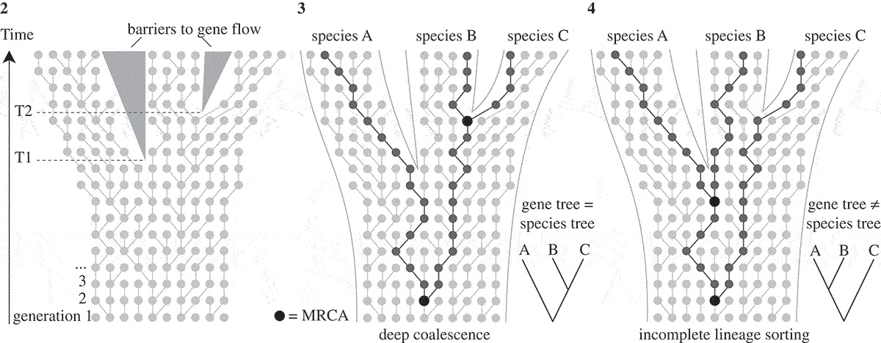
Incomplete lineage sorting (ILS)
Leliaert et al. (2013)

Slide 4
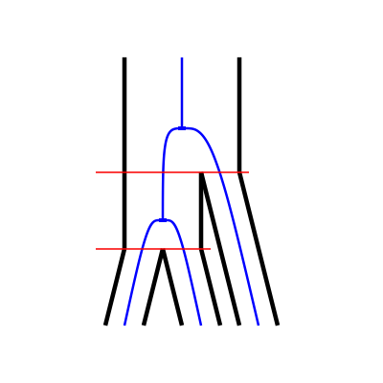
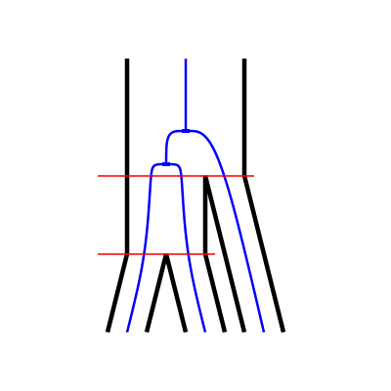
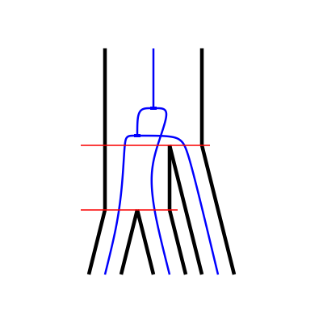
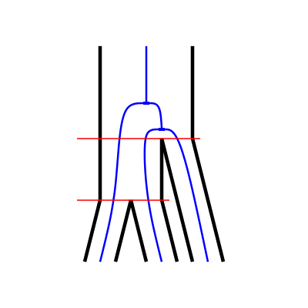
CoalHMM
V0
V1
V2
V3

Slide 5
CoalHMM
V0
V1
V2
V3
Split times.
Ancestral population sizes.
Mutation rate.
Recombination rate.
Parameterized by

Slide 6
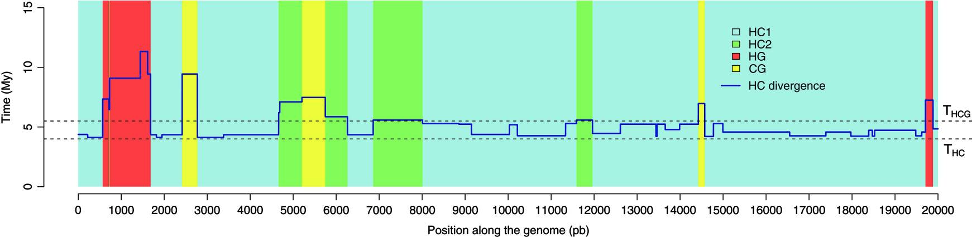
CoalHMM
Dutheil et al. (2009)

Slide 7
CoalHMM
V0
V1
V2
V3
Problem: parameter estimates are biased

Slide 8
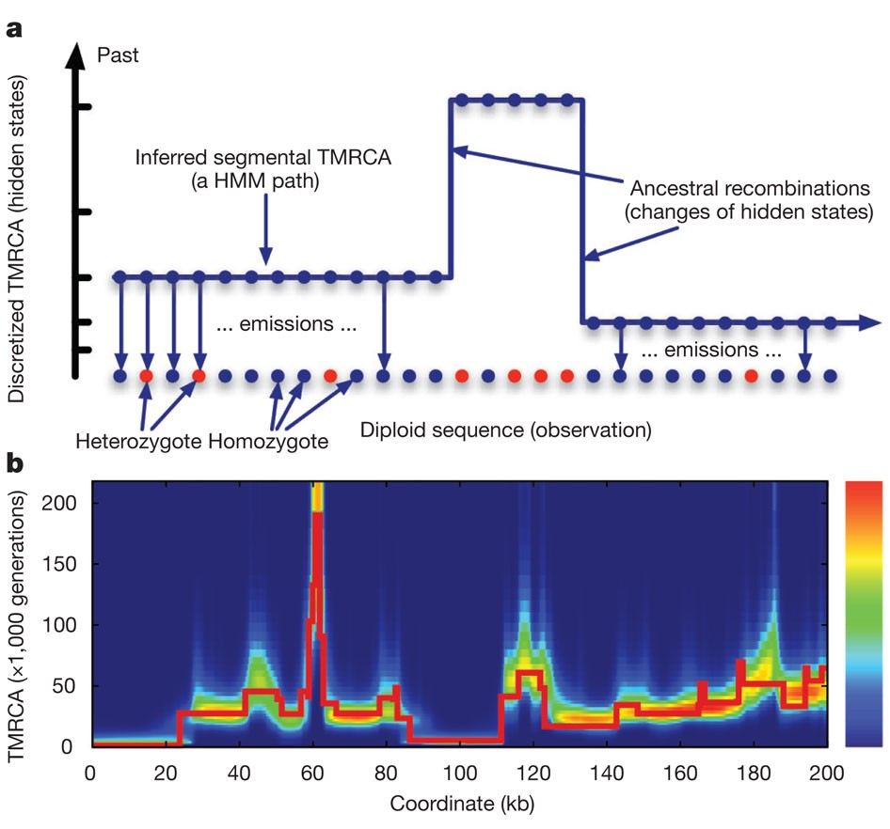
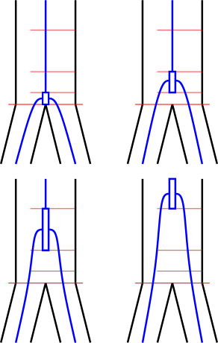
SMCs
Li and Durbin (2011)

Slide 9
SMCs
Parameterized by:
Ancestral population sizes.
Mutation rate.
Recombination rate.
Li and Durbin (2011)

Slide 10
SMCs
Parameterized by:
Ancestral population sizes.
Mutation rate.
Recombination rate.
Problems:
Only one coalescent event is modeled
Li and Durbin (2011)

Slide 11
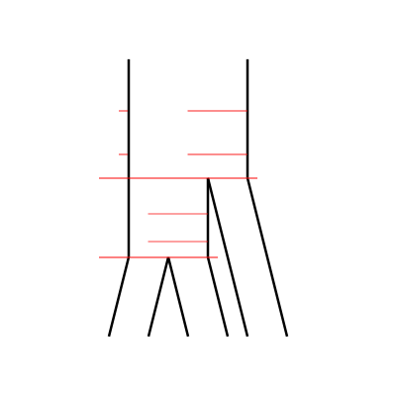
ILSMC
ILSMC:
Extract the ILS information CoalHMM-style
Parameterize SMC-style.

Slide 12
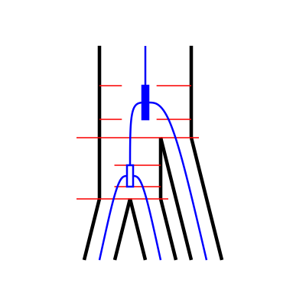
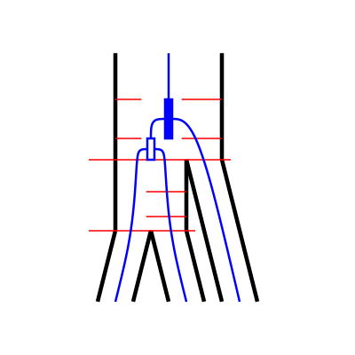
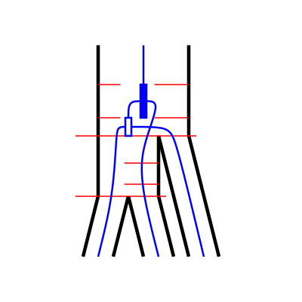
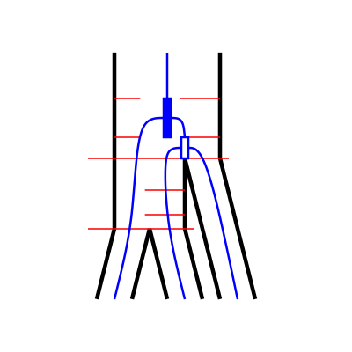
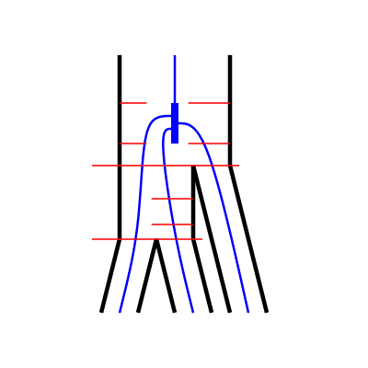
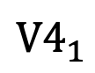
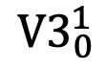
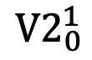
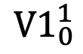
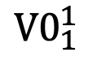
The hidden states
$${V0}_{1}^{1}$$
$${V1}_{0}^{1}$$
$${V2}_{0}^{1}$$
$${V3}_{0}^{1}$$
$${V4}_{1}^{ }$$

Slide 13
The hidden states
$${V0}_{1}^{1}$$
$${V1}_{0}^{1}$$
$${V2}_{0}^{1}$$
$${V3}_{0}^{1}$$
$${V4}_{1}^{ }$$
Parameterized by:
Split times.
Ancestral effective population sizes.
Number of intervals for discretization.
Recombination rate.
Mutation rate.

Slide 14
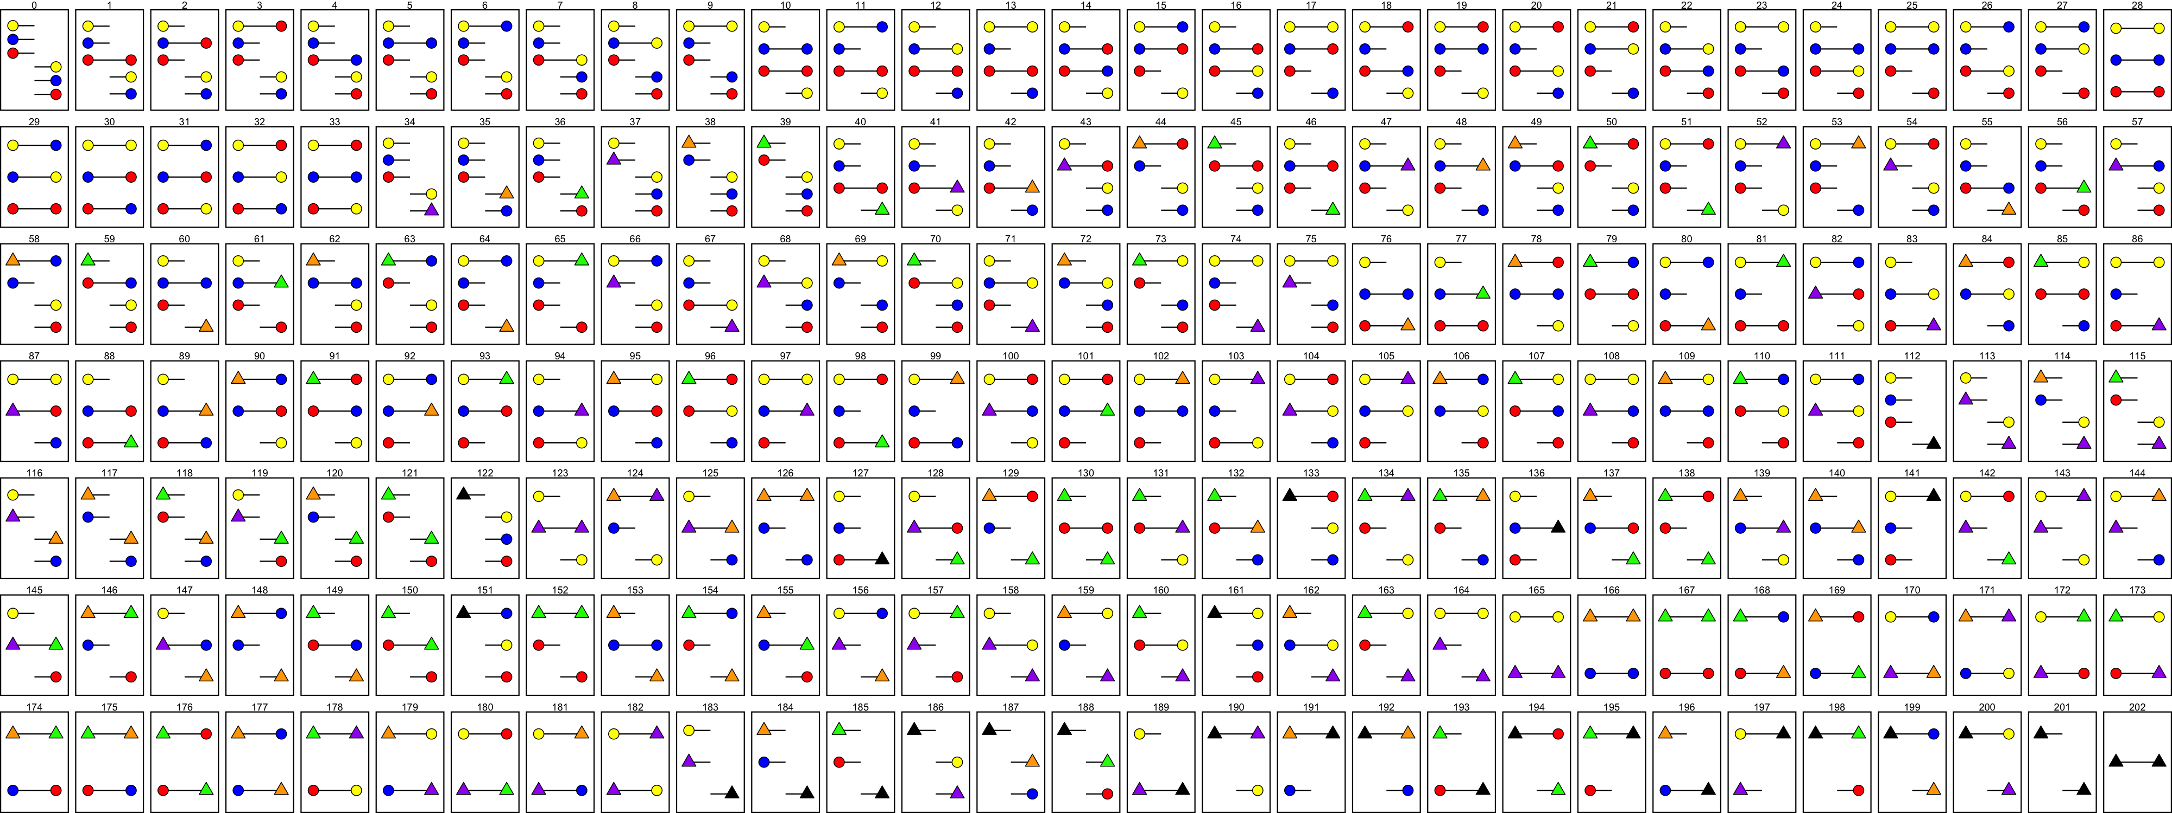
The CTMCs
Three-sequence CTMC
Two-sequence CTMC
One-sequence CTMC
One-sequence CTMC
One-sequence CTMC

Slide 15
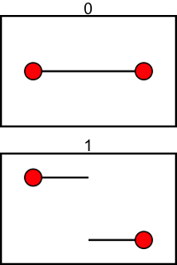
The CTMCs
1C
1R

Slide 16
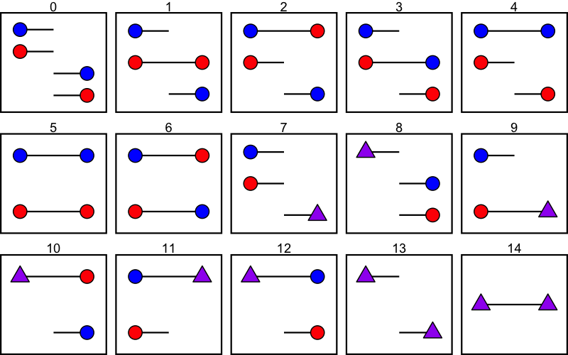
The CTMCs

Slide 17
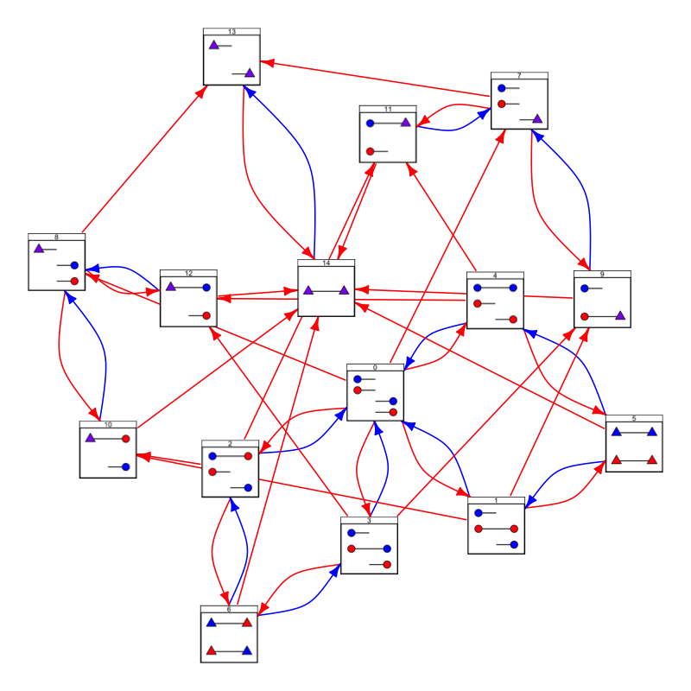
The CTMCs

Slide 18
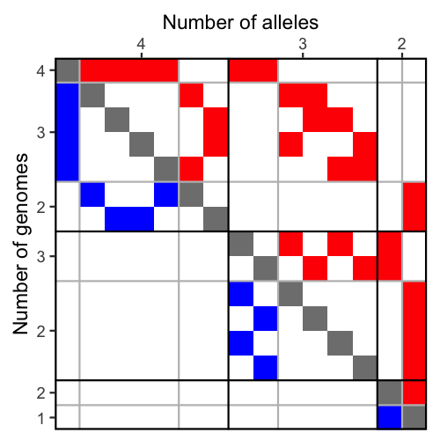
The CTMCs

Slide 19
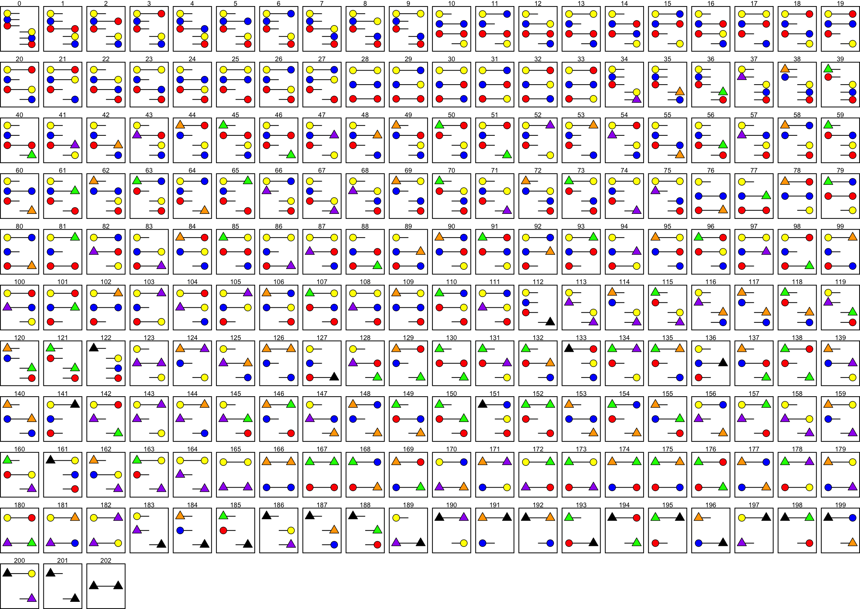
The CTMCs

Slide 20
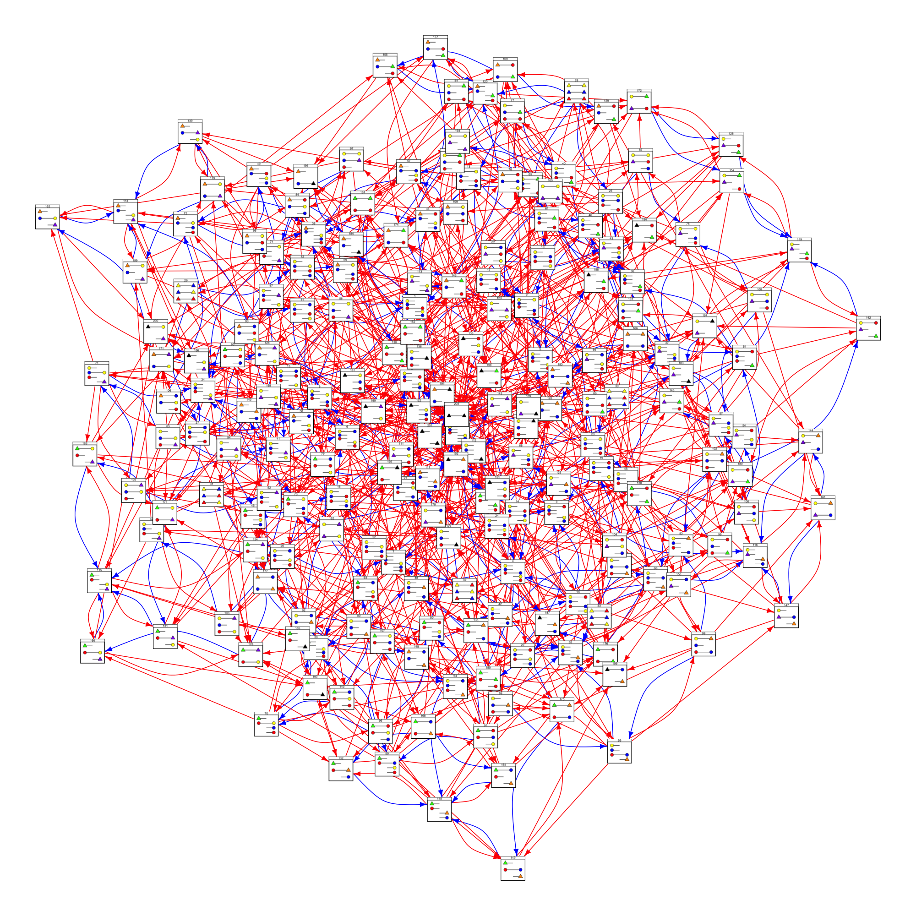
The CTMCs

Slide 21
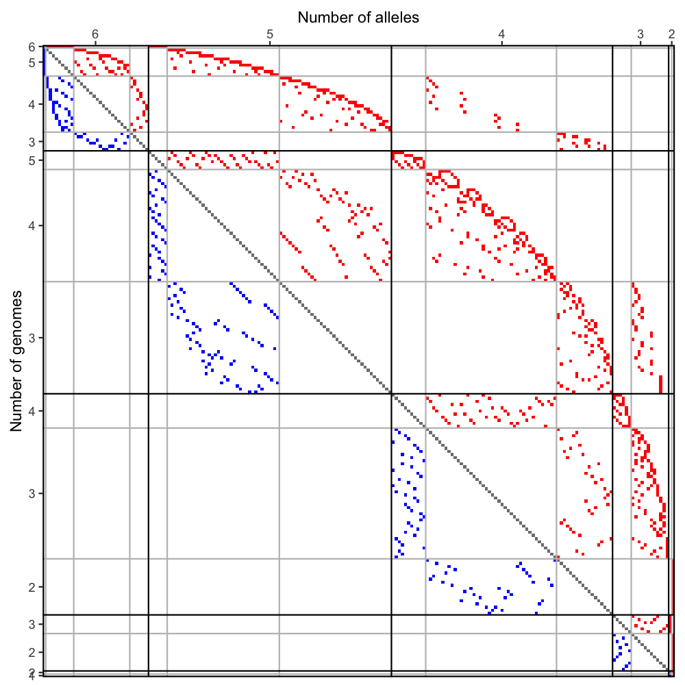
The CTMCs

Slide 22
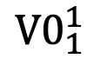
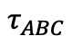
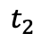
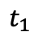
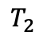
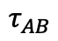
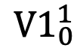
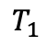
The transition probability matrix
Left site
Right site
$${V0}_{1}^{1}$$
$${V1}_{0}^{1}$$
$$T_{2}$$
$$T_{1}$$
$$τ_{ABC}$$
$$t_{2}$$
$$t_{1}$$
$$τ_{AB}$$

Slide 23
The transition probability matrix
Left site
Right site
$${V0}_{1}^{1}$$
$${V1}_{0}^{1}$$
$$T_{2}$$
$$T_{1}$$
$$τ_{ABC}$$
$$t_{2}$$
$$t_{1}$$
$$τ_{AB}$$

Slide 24
The transition probability matrix
Left site
Right site
$${V0}_{1}^{1}$$
$${V1}_{0}^{1}$$
$$T_{2}$$
$$T_{1}$$
$$τ_{ABC}$$
$$t_{2}$$
$$t_{1}$$
$$τ_{AB}$$

Slide 25
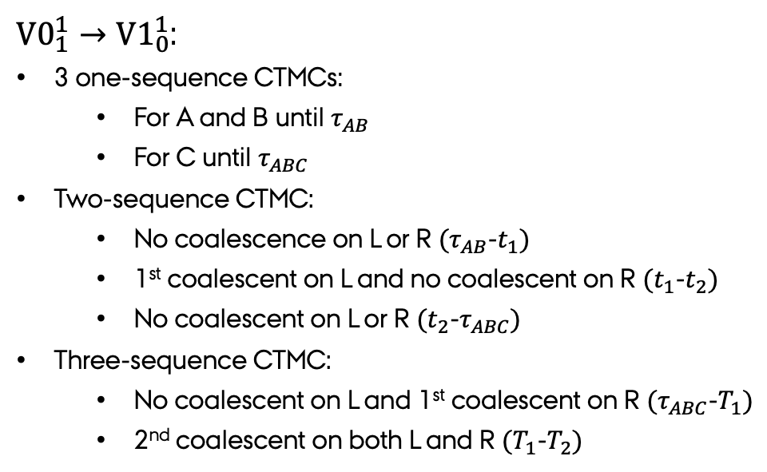
The transition probability matrix
Left site
Right site
${V0}_{1}^{1}→{V1}_{0}^{1}$:
3 one-sequence CTMCs:
For A and B until $τ_{AB}$
For C until $τ_{ABC}$
Two-sequence CTMC:
No coalescence on L or R $(τ_{AB}$-$t_{1})$
1st coalescent on L and no coalescent on R $(t_{1}$-$t_{2})$
No coalescent on L or R $(t_{2}$-$τ_{ABC})$
Three-sequence CTMC:
No coalescent on L and 1st coalescent on R $(τ_{ABC}$-$T_{1})$
2nd coalescent on both L and R $(T_{1}$-$T_{2})$
$${V0}_{1}^{1}$$
$${V1}_{0}^{1}$$
$$T_{2}$$
$$T_{1}$$
$$τ_{ABC}$$
$$t_{2}$$
$$t_{1}$$
$$τ_{AB}$$

Slide 26
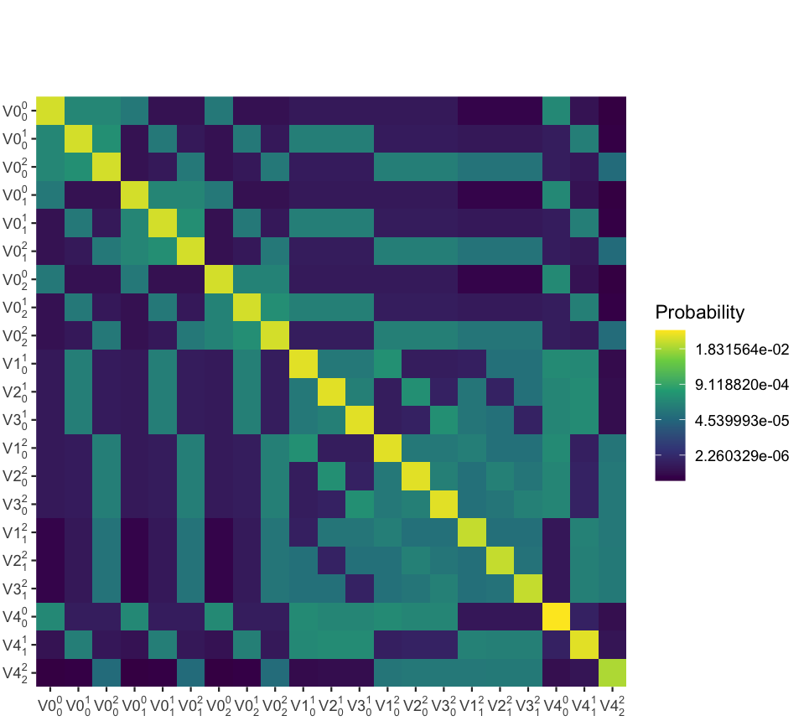
The transition probability matrix
Joint probability matrix
Left site
Right site

Slide 27
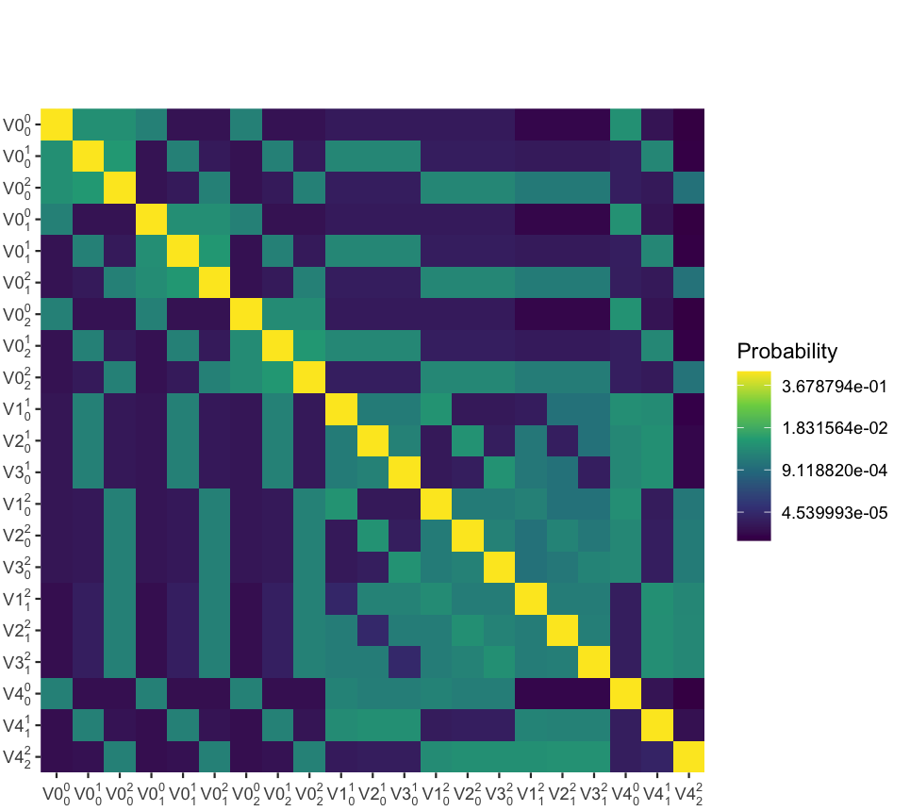
The transition probability matrix
Joint probability matrix
Transition probability matrix
Left site
Left site
Right site
Right site

Slide 28
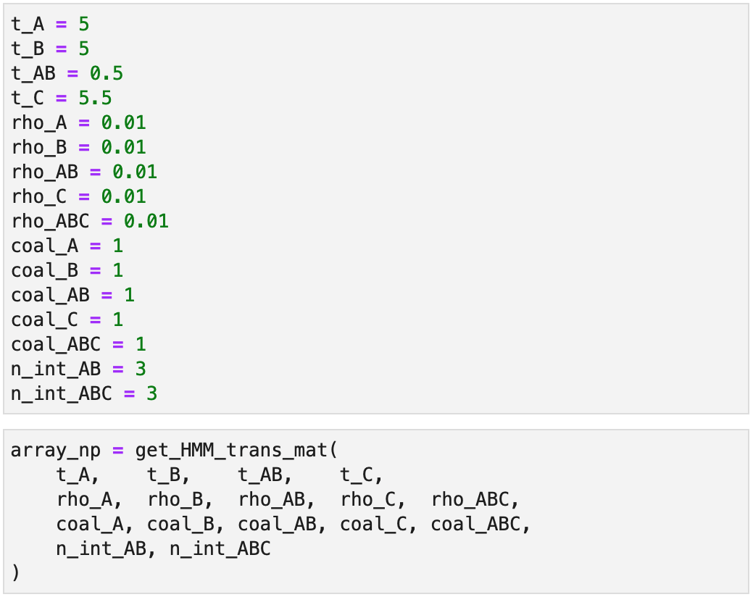
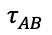
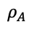
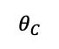
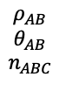
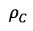
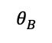
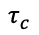
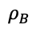
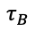
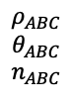
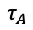

The transition probability matrix
Transition probability matrix
$$ρ_{ABC}$$
$$θ_{ABC}$$
$$n_{ABC}$$
$$ρ_{AB}$$
$$θ_{AB}$$
$$n_{ABC}$$
$$τ_{AB}$$
$$ρ_{C}$$
$$θ_{C}$$
$$τ_{c}$$
Left site
$$τ_{A}$$
$$ρ_{A}$$
$$ρ_{B}$$
$$τ_{B}$$
$$θ_{A}$$
$$θ_{B}$$
Right site

Slide 29

Simulating from the model

Slide 30

Simulating from the model
2
1
Deep
0
2
Shallow
1
0

Slide 31
Discussion
Current state:
Transition probability matrix calculated

Slide 32
Discussion
Current state:
Transition probability matrix calculated
Future work:
Optimize transition probability matrix
Emission probabilities.
Chose and code optimization procedure.
Analyze simulated data.

Slide 33
Discussion
Current state:
Transition probability matrix calculated
Future work:
Optimize transition probability matrix
Emission probabilities.
Chose and code optimization procedure.
Analyze simulated data.
Future perspective:
ILSMC is flexible:
Different parameterization per interval
ILSMC is extensible:
ILS and introgression.

